Slide 1
ADVANTAGES OF HYBRID APPLICATION AND DISADVANTAGES OF OTHER APPLICATION
ADVANTAGES:
Reduced Development Costs
Improved UI/UX
Ease of Integration
Offline Support
Simplified Maintenance
DISADVANTAGES OF NATIVE APPLICATION:
Expensive to develop
Maintenance cost is high
Approval by the app store
Compatible issues
DIS ADVANTAGES OF WEB APPLICATION:
Internet reliance
Security
Reduced Speed
Browser support

Slide 2
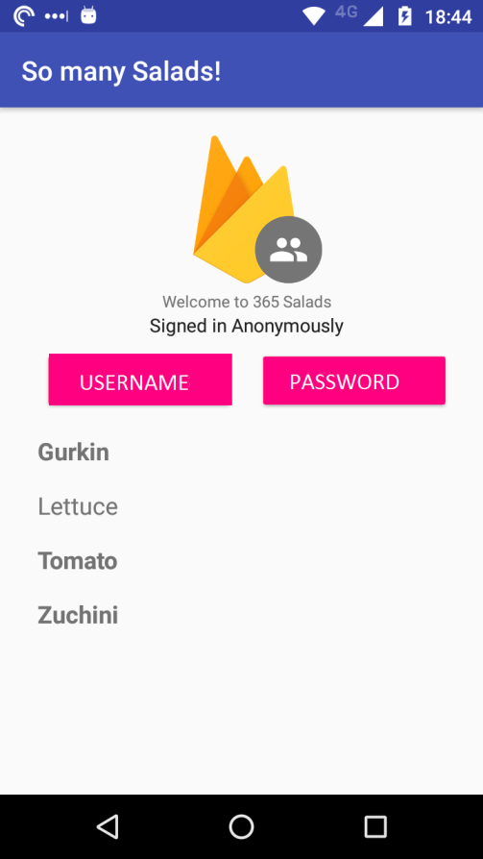
HOW TO USE RELISH?
The Firebase Real time Database is a cloud-hosted database. Data is stored as JSON and synchronized in real time to every connected client. When you build cross-platform apps with our iOS, Android, and JavaScript SDKs, all of your clients share one Real time Database instance and automatically receive updates with the newest data.

Slide 3
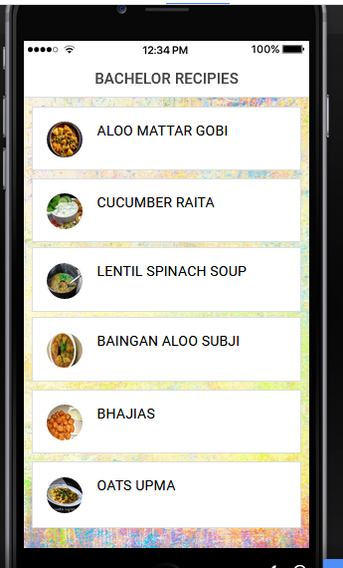
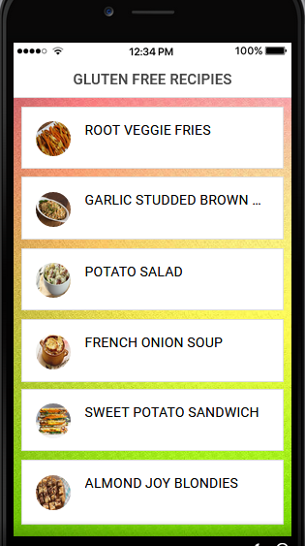
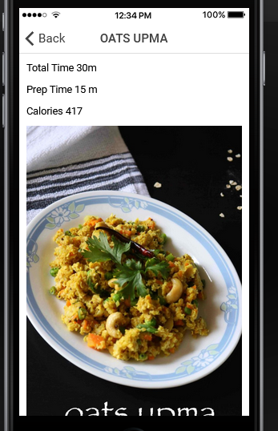
SCREEN SHOTS

Slide 4
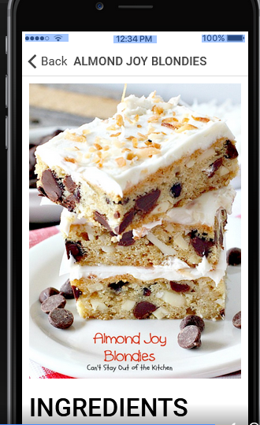
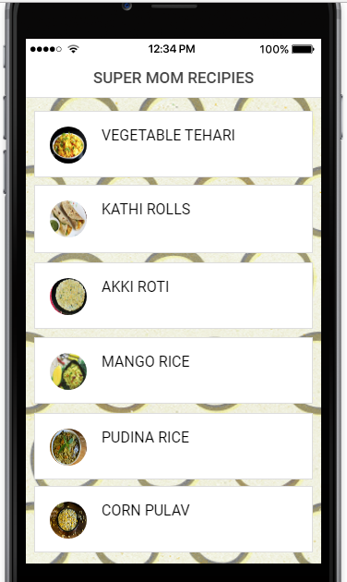
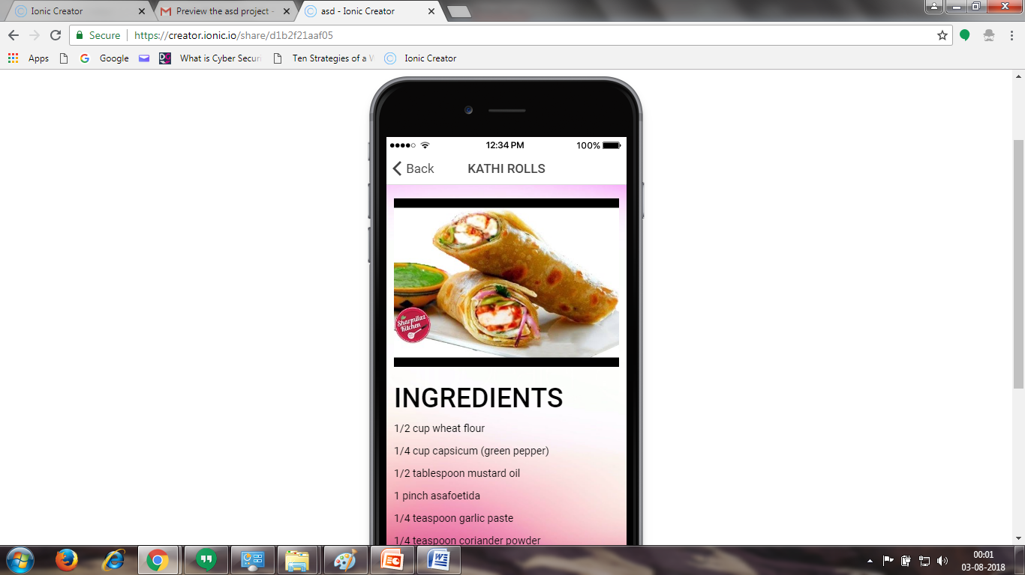

Slide 5
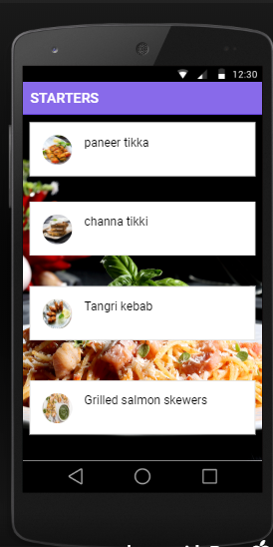
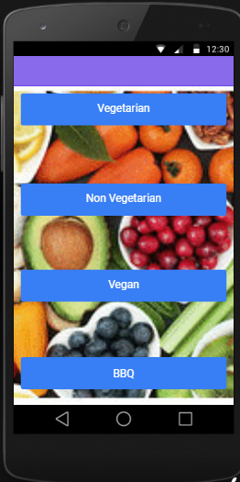
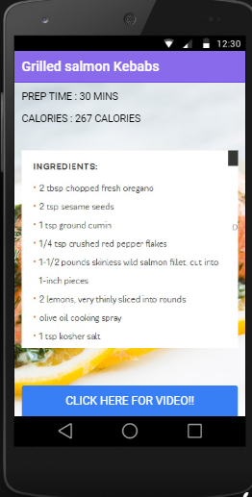

Slide 6

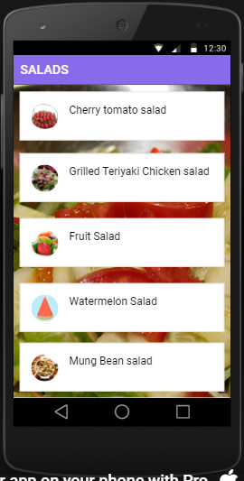
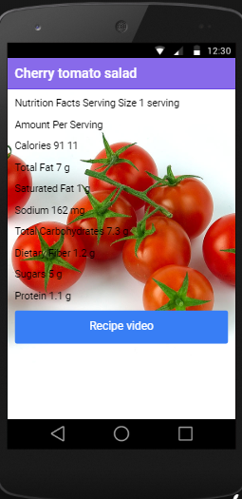
https://www.youtube.com/watch?time_continue=36&v=r96BDQttNjg

Slide 7

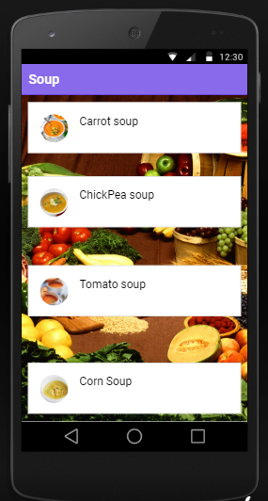
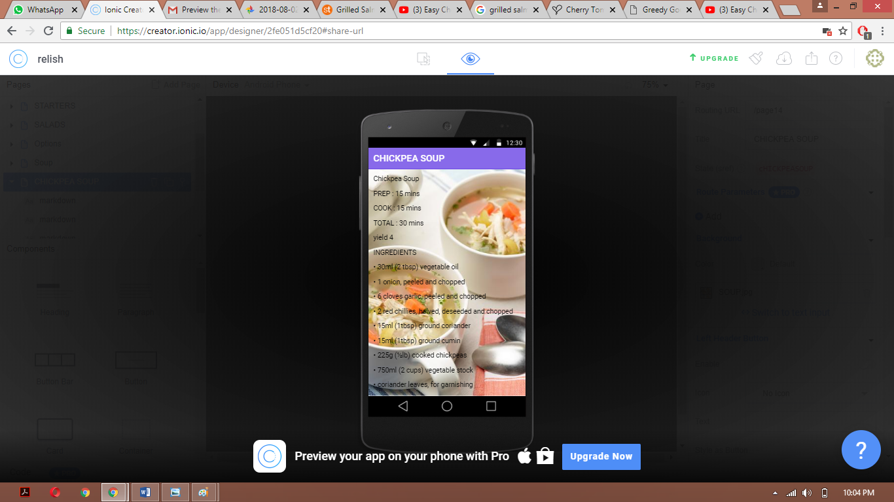
-https://www.youtube.com/watch?v=LNKIVarFDgU&t=8s

Slide 8
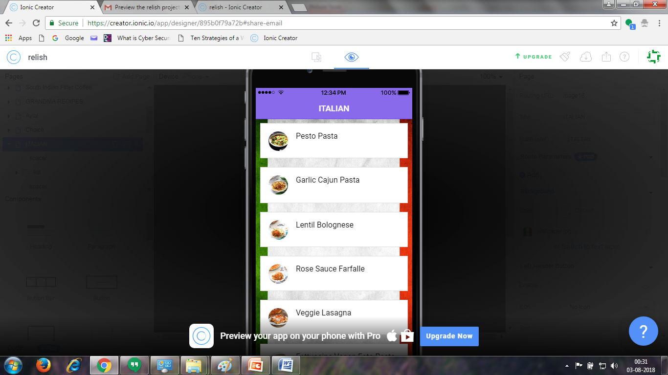
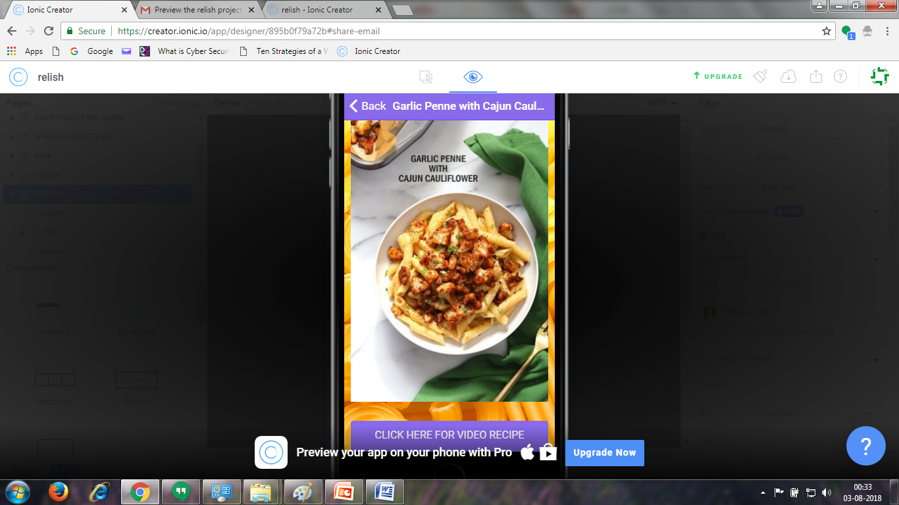
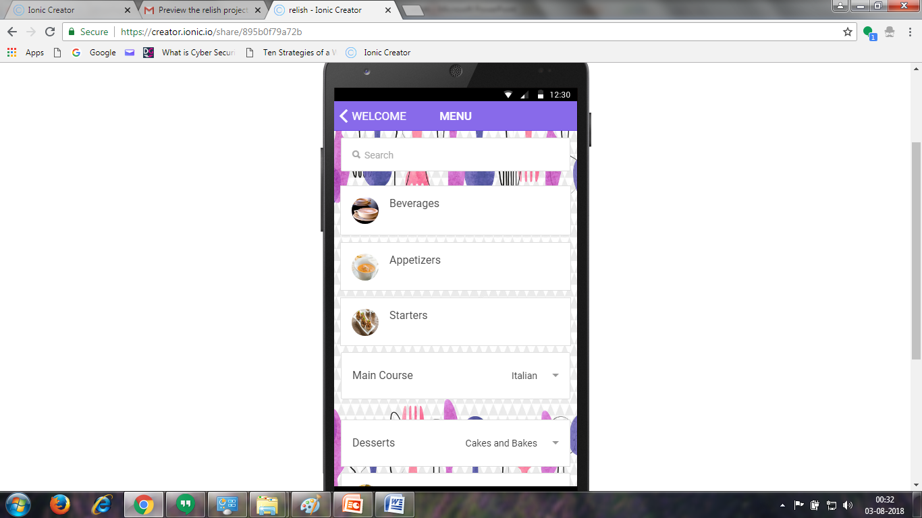

Slide 9
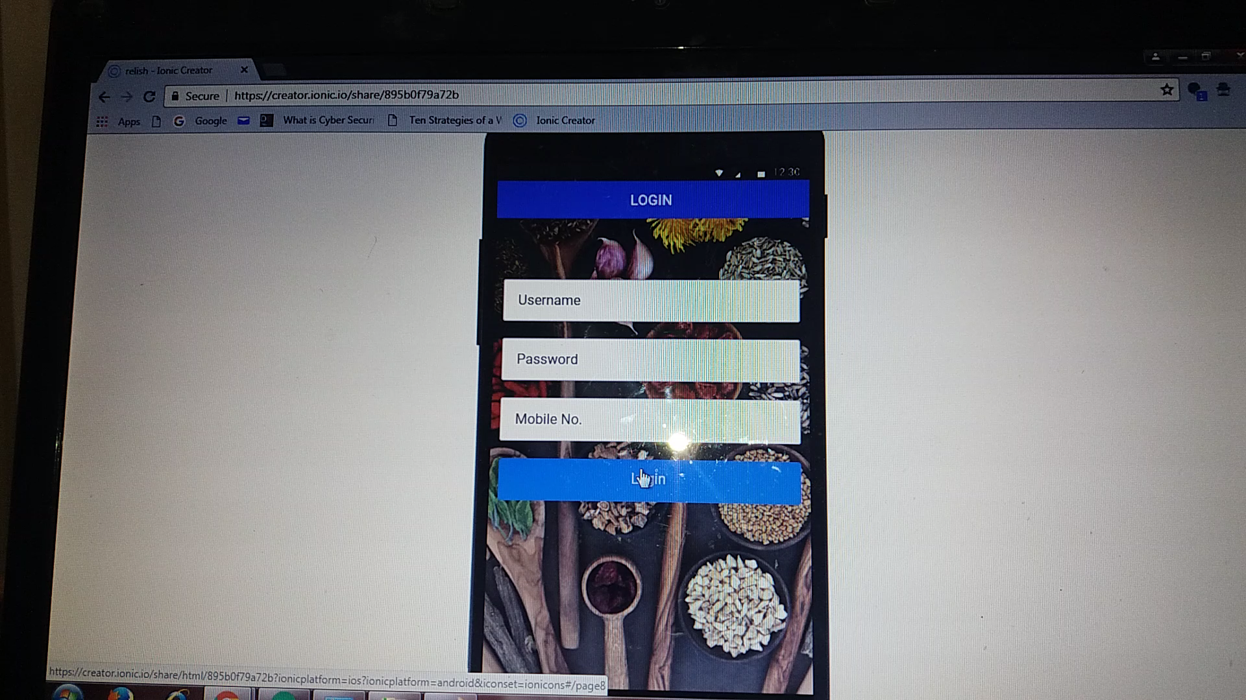
PREVIEW

